Slide 1
Welcome!
Question of the Day:
‹#›

Slide 2
7.5 Multidimensional Arrays
PROFESSOR RAMSEY
GDC 6.318
ramsey@cs.utexas.edu

Slide 3
Updated Help Hours

Slide 4
Unit 2 Test Info
The test focuses on Chapters 3G - 7. Understanding of material previously covered in Chapters 1 - 3 is necessary, but not the focus.
Tuesday (week before) 10/17 | Friday 10/20 | Weekend | Monday 10/23 | Tuesday 10/24 | Wednesday 10/25
Mock Test New Exam 6:30 - 9:30pm GDC 2.216 | Design Sessions Fall 2019 Exam Q&A | Meet with Study Group to take Practice Tests | Test Review in Section Practice Test Live! New Exam 7-8:30pm GDC 4.302 | Test Review Fall 2018 Exam 7-8pm WEL 2.246 | Test Review in Lecture TEST* 6:30-8:30pm WEL 2.224
* There is an extra time test and a make-up test for students who have been approved ahead of time. There is also an alternate test time for students with a UT testing conflict and who have been approved ahead of time. The day, time and location of these tests will be emailed to the approved students.

Slide 5
Quiz

Slide 6
6.5
Multidimensional Arrays

Slide 7
Remember Console Output
Console output consists of lines/rows and columns (ASCII-based, non-proportional fonts)
Outside loop ran once per row.
Inside loop ran for one or more characters in one row.
rows
columns

Slide 8
Remember Nested Loops…
Rocket Top:
loop once per line
print spaces
print forward slashes
print “**”
print backward slashes

Slide 9
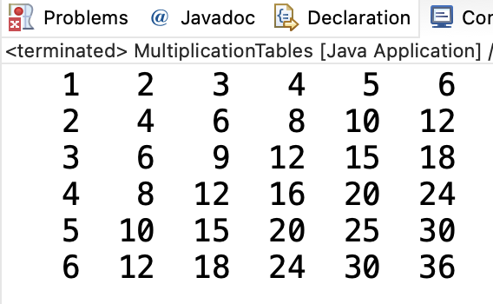
Remember Rows and Columns…
i | j
1 | 1 2 3 4 5 6
2 | 1 2 3 4 5 6
3 | 1 2 3 4 5 6
4 | 1 2 3 4 5 6
5 | 1 2 3 4 5 6
6 | 1 2 3 4 5 6
cols (j)
rows (i)

Slide 10
Demo
Demo 1
What is wrong with this code?

Slide 11
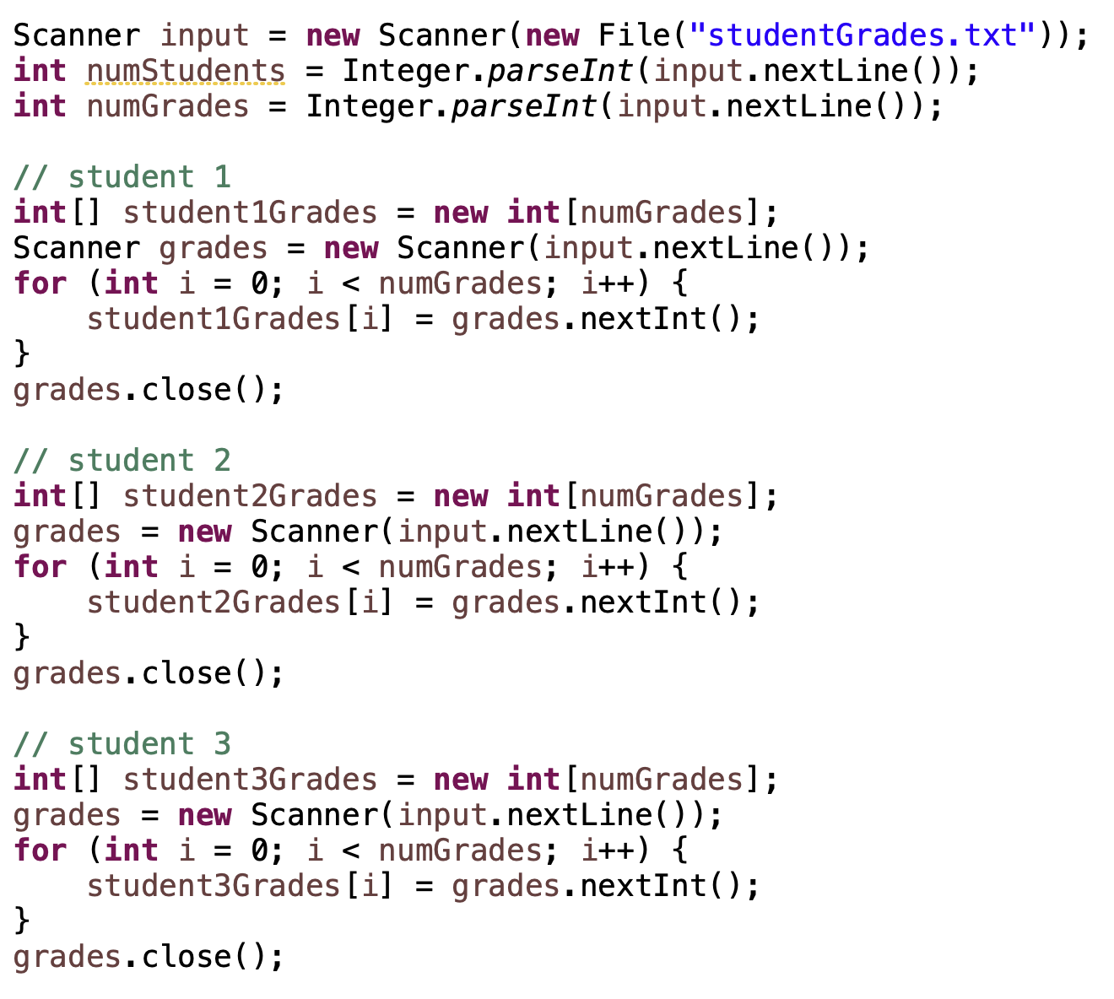
Demo Code
3 grade arrays in memory
Student 0 | [0] | [1] | [2] | [3] | [4]
 | 89 | 91 | 70 | 94 | 63
Student 1 | [0] | [1] | [2] | [3] | [4]
 | 67 | 23 | 98 | 54 | 99
Student 2 | [0] | [1] | [2] | [3] | [4]
 | 89 | 87 | 85 | 89 | 90

Slide 12
What if you could have an array of arrays?
[j]
Array of Students
[0]
[1]
[2]
Array of
Grades
Student 0 | [0] | [1] | [2] | [3] | [4]
 | 89 | 91 | 70 | 94 | 63
[i]
Student 1 | [0] | [1] | [2] | [3] | [4]
 | 67 | 23 | 98 | 54 | 99
Student 2 | [0] | [1] | [2] | [3] | [4]
 | 89 | 87 | 85 | 89 | 90
int[][] studentGrades = new int [numStudents][numGrades];
studentGrades[1] // one student’s grades
studentGrades[0][1] // one grade, 91, the second grade for the first student

Slide 13
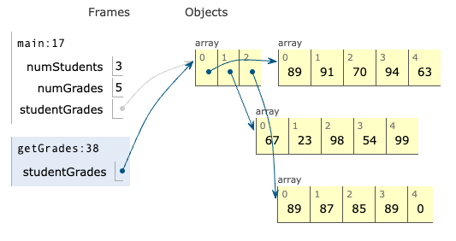
2D Student Grades in Python Tutor

Slide 14
Demo
Demo 2
Write getGrades().

Slide 15
Design

Slide 16
Demo Code

Slide 17
In-Class Practice
Design
StudentGrades.java
Write displayGrades()
Calling code:
Output:

Slide 18
In-Class Practice
Code
StudentGrades.java
Write displayGrades()
Calling code:
Output:

Slide 19
Design

Slide 20
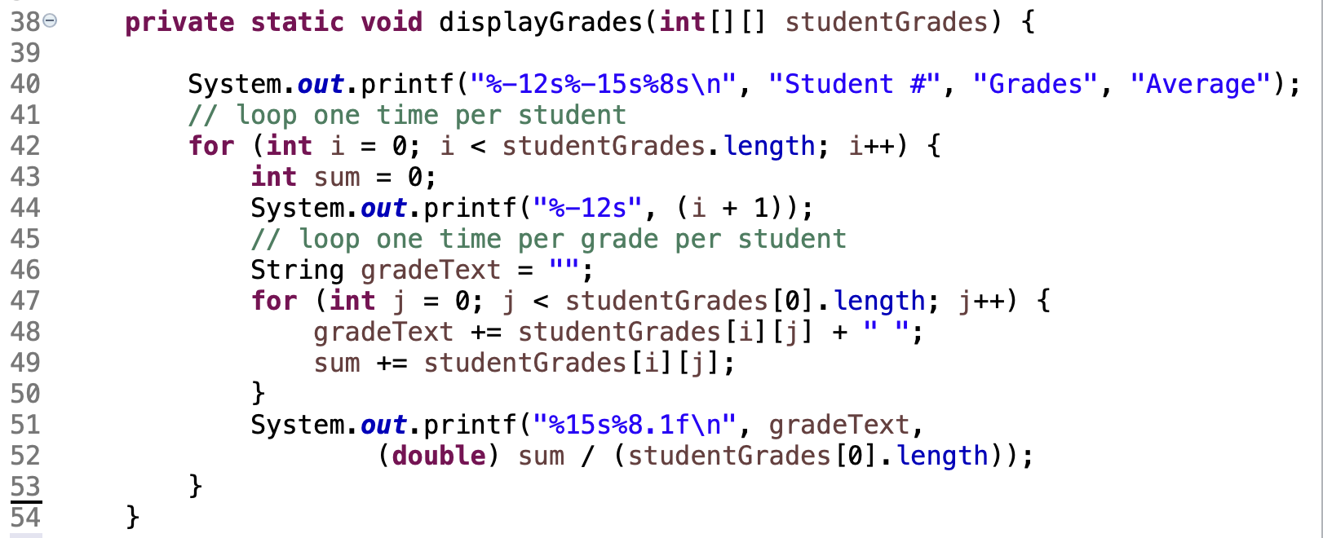
Solution

Slide 21
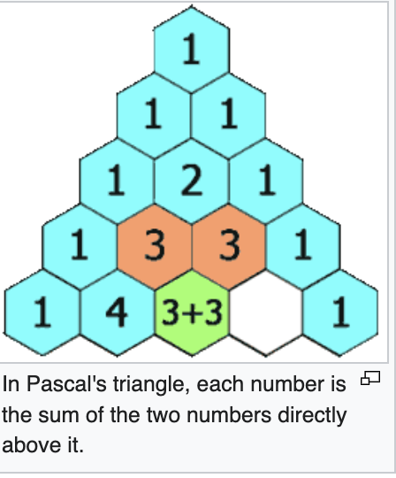
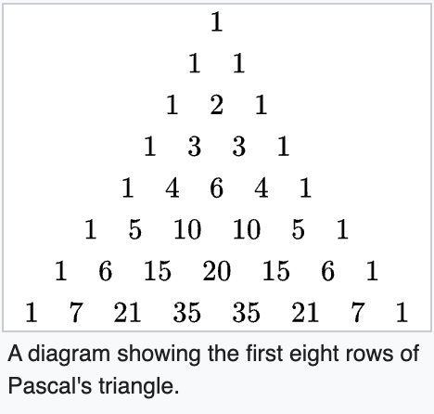
Pascal’s Triangle
More information at https://en.wikipedia.org/wiki/Pascal%27s_triangle#Overall_patterns_and_properties

Slide 22
Store Numbers in Pascal’s Triangle
1D or 2D arrays?
OK to waste space?
How do you mark space not used?
I wish…

Slide 23
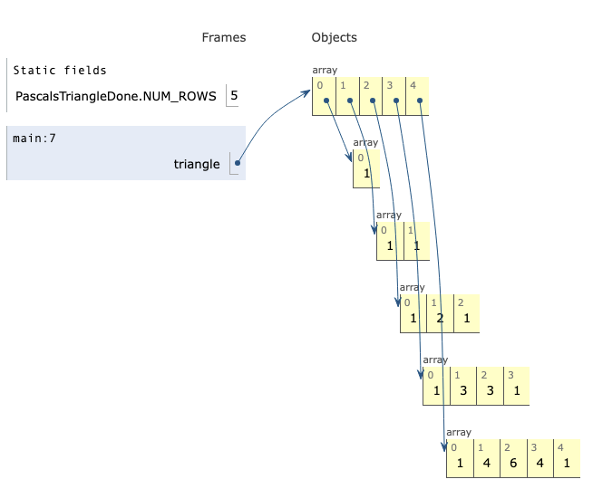
A Jagged Array
Pascal’s Triangle with 5 rows

Slide 24
Initially create an array for a given number of rows:
Later, create each row’s array individually:
To get the number of rows:
To get the number of columns in each row:

Slide 25
Demo
Demo 3
Write createPascalTriangle().

Slide 26
Design

Slide 27
Solution

Slide 28
Remember
You Belong Here
Hi!

